Slide 1








FLAVOR
FORGE
AI- Powered Personalized Flavor Creator
Group 3 Members: Ammar, Pragathi, Kshitij, Soraia, Karthik, Rupa,
MIE 671 Product Management-Nehal Patel

Slide 2

PROBLEM STATEMENT
Limited Personalized Food Experiences:
Traditional meal planning apps and recipe platforms offer generalized suggestions without understanding individual taste preferences, moods, or dietary restrictions​.
Repetitive and Boring Eating Habits:
Many individuals fall into monotonous eating routines, struggling to find inspiration for new, customized flavor combinations​.
Difficulty Managing Dietary Restrictions:
Users with allergies, specific diets (e.g., vegan, keto, pescatarian), or cultural dietary needs find it hard to access flavorful, adaptive recipes​.
Inefficient Flavor Innovation for Businesses:
Restaurants, chefs, and food brands lack AI-driven tools to predict customer preferences, optimize menus, and innovate unique flavor offerings​​.
Fragmented User Experiences:
Existing solutions (recipe apps, meal kits, etc.) do not integrate real-time food scanning, mood-based adaptations, or sustainability insights into a seamless ecosystem

Slide 3



PRODUCT VISION
Bridge R&D and consumer insights via data-driven design
Democratize flavor innovation through AI
Empower chefs, brands, and food scientists to create ahead of the curve

Slide 4



WHO THIS IS FOR??
🏢 Food & Beverage Startups
🛒 CPG Brand Managers
🎓 Food Science Researchers
🧑‍🍳 Culinary
R&D Teams

Slide 5



Track and forecast emerging flavor trends globally
#1
Simulate flavor combinations with predicted appeal
#2
STRATEGIC GOALS & OBJECTIVES
Accelerate concept development cycles
#3
Enable data-backed decisions in culinary innovation
#4

Slide 6
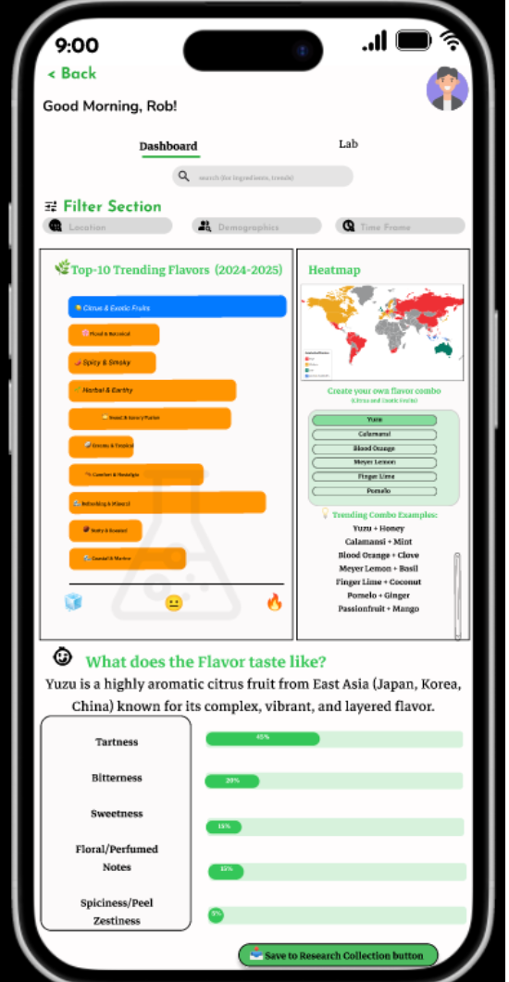
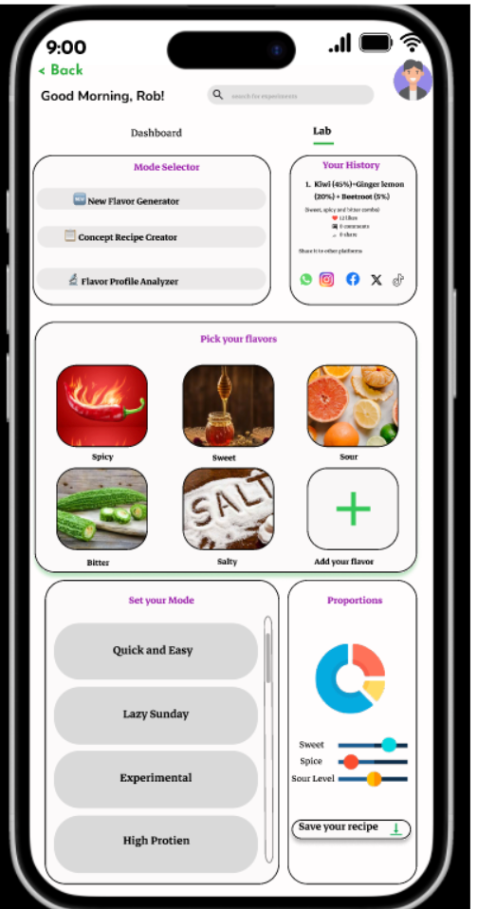
WHAT WE’RE BUILDING
AI Flavor Trends Dashboard: Visualize what’s hot, where, and why
Flavor Innovation Lab: Prototype, simulate, and refine new recipes
Seamless user journey from trend → idea → test-ready concept

Slide 7
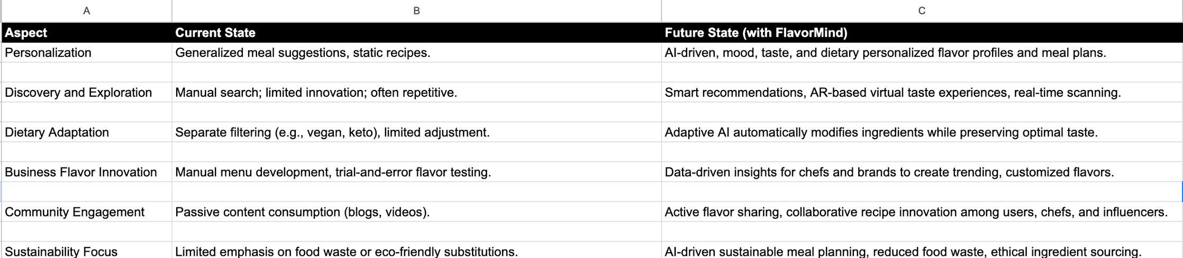
CURRENT STATE
VS.
FUTURE STATE

Slide 8
MARKET STRATEGY AND PLANNING
THE 5C’S
1.Company
2.Customers
3.Competitors
4.Collaborators
5.Context

Slide 9

SWOT ANAYLSIS
Opportunities
Expand into personalized grocery shopping partnerships
Corporate wellness programs (B2B model)
Monetize sustainable product recommendations
International expansion with cultural flavor localization
Strengths
AI-based hyper-personalization (taste, mood, diet)
Grocery planning integration
Sustainable meal suggestions
Dynamic flavor pairing engine
Threats
Other apps adopting AI features quickly
Consumer trust issues around AI recommendations
Shifting dietary trends could require fast adaptation
Data privacy regulations
Weaknesses
New player with low brand awareness
Requires consistent data input by users
Potential challenges adapting to different cuisines and regions
Dependence on third-party grocery platforms for fulfillment

Slide 10
PESTEL ANALYSIS
FACTORS
IMPLICATION
Political
Economic
Social
Technological
Environmental
Legal
Compliance with GDPR, CCPA, and global data privacy standards
Increased home cooking and grocery ordering; recession-proof convenience focus
Rising desire for healthy, personalized eating; sustainability-driven choices
Advances in AI and mobile app ecosystems; no dependency on smart hardware
Pressure for food sustainability; reducing food waste is key for brand positioning
Need for clear disclaimers around dietary advice (medical, allergies); strong privacy protections

Slide 11
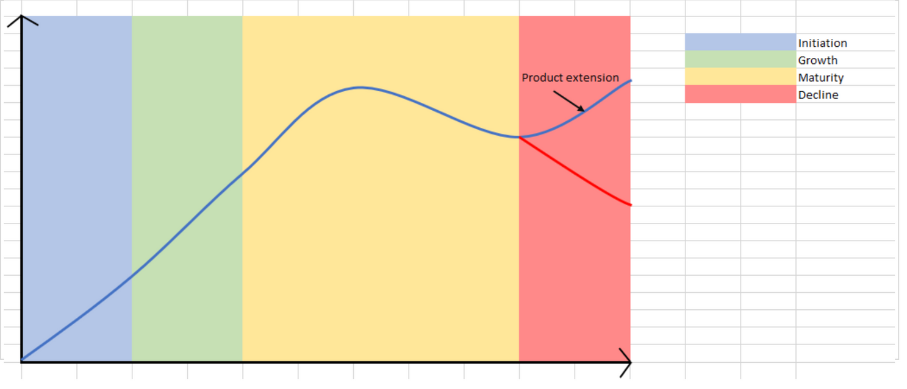
PRODUCT LIFECYCLE
Initiation:
First we Identify a problem - boring & unhealthy eating habits, lack of personalized flavor experiences in suggestions, and struggles with dietary adaptations.
Conduct interviews and surveys to gather user feedback for deeper understanding.
After gathering feedback we find solutions to address the finest problems.
Make a Minimum Viable Product (MVP) which delivers:
Generates personalized flavor
Dietary restriction adaptation, and potentially
5. This stage of the product will strive to cater for the food lovers, diet-conscious folk and chef
6. Biggest challenge would be:
Low user base
Higher cost per user to modify the app to promptly address any issues.

Slide 12
PRODUCT LIFECYCLE
Growth:
During the growth stage our target customers go from early adopters to more mainstream customer base like home cooks,
To cater to a wider customer base we need to also add features like mood based suggestions and/or Restaurant/brand partnerships to offer exclusive flavor content.
Launch subscriptions for more advanced features like recipes videos, exclusive recipes, and more.
The revenue from the subscription will be used to market aggressively on social media, TV, and sponsorships.

Slide 13
PRODUCT LIFECYCLE
Maturity:
This is the peak of the products lifecycle where retaining the acquired customers is crucial as the competition is at its highest.
Some simple yet effective strategies would be to introduce a loyalty rewards, referral programs and even personalisation options to make the app more interesting.

Slide 14
PRODUCT LIFECYCLE
Decline:
1. After its prime, there would be indications of a steady decline in the product, such as:
Market saturation.
Declining user engagement or subscription revenue.
Competitor innovation is outpacing our own.
2. A major reinvention would be required if the product enters this stage.

Slide 15
PRODUCT LIFECYCLE
Product Extension:
To prevent decline, we must keep expanding and innovating to improve our offerings
Sync with Apple Health, Fitbit, or Oura
Flavour Forge Kids - Introduce a kids menu feature for healthy and tasty recipes options.
Introduce an in app store to buy spices

Slide 16




AI-Driven Personalization
Build an AI engine to analyze user preferences, moods, and dietary needs for personalized flavor and meal suggestions.
Real-Time Food Scanning & Mapping
Develop a mobile app that can scan food items and recommend optimized ingredient pairings instantly.
Adaptive Dietary Support
Ensure the platform automatically adjusts recipes for dietary restrictions (e.g., vegan, keto, allergies) without compromising taste.
B2B Data Insights for Restaurants & Brands
Offer businesses AI-powered analytics for menu optimization, flavor innovation, and consumer taste trend predictions.
Community Sharing Platform
Create a social feature allowing users, chefs, and influencers to share custom flavor profiles, recipes, and food experiences.
KEY BUSINESS REQUIREMENTS

Slide 17
AI Recommendation Accuracy:
Risk of suggesting meals that don't match user taste or dietary needs, leading to dissatisfaction.
Mitigation:
Use continuous feedback loops and user rating systems to refine AI recommendations.
Allow manual override and easy customization of suggestions.
Incorporate taste learning through mood, preference history, and time-based patterns.
Data Privacy & Security:
Handling sensitive user data (health, preferences) requires strict compliance to avoid breaches and lawsuits.
Mitigation:
Implement GDPR/CCPA-compliant data storage and encryption.
Use anonymized data for training AI models. Conduct regular security audits and penetration tests
Consumer Trust in AI:
Skepticism about AI-driven food suggestions could slow user adoption without transparency and explainability.
Mitigation:
Ensure explainability with "Why this meal?" tooltips.
Allow users to rate and improve suggestions easily.
Use trusted influencer/chef endorsements to build credibility.
PRODUCT RISK & MITIGATION

Slide 18
Regulatory Compliance Risks
Risk: Violations in food labeling, allergen data, or data handling laws could result in penalties.
Mitigation:
Use compliance-by-design principles in development.
Partner with legal consultants for food safety and data law review.
Integrate auto-labeling for allergens in recipe displays.
Technology Integration Challenges
Risk: Incompatibility or syncing issues with diverse kitchen devices.
Mitigation:
Start with widely-used APIs (e.g., Samsung SmartThings, Alexa).
Create a modular architecture for future integrations.
Use fallback manual inputs when device connection fails.
Market Competition
Risk: Competitors like Yummly or Noom may launch similar features.
Mitigation:
Focus on niche differentiation: mood-based flavor personalization + sustainability tracking.
Build strong brand-community loyalty with shareable content and influencers.
Protect core algorithms with patents and IP filings.
Operational Costs
Risk: High cloud, AI model, and sustainability expenses can hurt margins.
Mitigation:
Use lightweight ML models optimized for mobile.
Apply auto-scaling cloud infrastructure.
Seek early-stage sustainability and innovation grants.
PRODUCT RISK & MITIGATION

Slide 19

PERFORMANCE
1. AI Personalization Accuracy
KPI: Recommendation Match Rate
Success Measure: % of user feedback (ratings ≥4/5) indicating taste or dietary alignment with AI suggestions
Target: ≥85% positive feedback from users over 30 days of use
2. User Engagement Rates
KPI 1: Daily Active Users (DAU) / Weekly Active Users (WAU)
Success Measure: DAU/WAU ratio > 0.3 indicates high retention
KPI 2: Average Session Duration
Success Measure: >5 minutes/session for recipe or flavor exploration
3. Recipe and Flavor Scan Success Rate
KPI 1: Scan Accuracy Rate
Success Measure: ≥95% correct identification of food items/flavors
KPI 2: Recommendation Speed
Success Measure: <3 seconds per optimized suggestion
4. Dietary Adaptation Effectiveness
KPI: Dietary Satisfaction Score
Success Measure: ≥80% positive feedback from users with dietary filters (e.g., vegan, keto, allergy)
5. Smart Kitchen Integration Performance
KPI 1: Device Sync Success Rate
Success Measure: ≥90% successful kitchen inventory scans
KPI 2: Auto-Suggested Meal Usage Rate
Success Measure: ≥70% of connected users try AI-suggested meals at least once per week
6. B2B Client Analytics
KPI 1: Report Utilization Rate
Success Measure: ≥80% of clients use insights monthly
KPI 2: Client Satisfaction Score
Success Measure: ≥4/5 average rating in quarterly feedback
7. Data Privacy & Security Compliance
KPI 1: Audit Pass Rate
Success Measure: 100% compliance in quarterly GDPR/CCPA audits
KPI 2: Security Incident Rate
Success Measure: Zero major breaches per year
8. Environmental Impact Metrics
KPI 1: Food Waste Reduction per User
Success Measure: ≥20% reduction in average weekly waste after 3 months of use
KPI 2: Restaurant Waste Optimization Rate
Success Measure: ≥25% improvement in waste metrics reported by B2B partners

Slide 20




Month 0–1: Discovery & Validation (Feb–Mar 2025)
Key Focus: Define the user problem, validate with data, and begin market research.
Conduct 200+ user interviews and surveys (foodies, culinary students, diet-conscious users, chefs).
Target groups: 80 Gen Z food lovers, 60 culinary students, 40 health/diet-conscious users, 20 chefs/brands.
Research 5 top competitors (Yummly, Noom, PlateJoy, Crave It, Forks Over Knives).
Finalize core personas:
“Maya” – 22, busy vegan college student
“Jordan” – 35, culinary innovation lead at a startup
“Samira” – 30, pescatarian mom of two
DEFINE THE PRODUCT LAUNCH
Month 2: MVP Definition & AI Modeling (Apr 2025)
Key Focus: Lock in features for launch, and begin AI development.
Define MVP scope:
Personalized flavor pairing engine
Grocery list builder
Dietary filters: vegan, gluten-free, keto, pescatarian
AI Team begins modeling first-gen recommendation engine using 10,000+ open-source recipe data points.
Begin initial wireframes and UX in Figma — targeting 4 user flows: onboarding, home dashboard, recipe view, grocery list.
Outreach to 3 regional culinary schools and 2 grocery chains for pilot partnerships )(UMass,Johnson & Wales, Central Market, Eataly).

Slide 21
Month 3: Prototype Build & Internal Testing (May 2025)
Key Focus: Build usable prototype and refine core algorithms.
Complete Version 0.5 internal prototype (in-app recipe generation, flavor profile quiz).
Run QA tests with 10 internal testers (team, advisors).
Begin integration of meal scanning UI, working toward grocery matching in later updates.
Launch private Notion or Slack community for beta feedback hub.
DEFINE THE PRODUCT LAUNCH
Month 4: Beta Testing & Iteration (June 2025)
Key Focus: Real-world usage and data collection.
Launch Closed Beta with 300 testers (split across 4 cities: 75 each in NYC, LA, SF, and Chicago).
Track key metrics:
Recipe match satisfaction ≥ 80%
Grocery list accuracy ≥ 90%
Weekly retention ≥ 50%
Collect 200+ feedback forms and conduct 15 follow-up interviews.
Begin social content collection: testimonials, app screen recordings, influencer quotes.
Update onboarding UI, streamline dietary preference input based on test friction points

Slide 22
Month 5: GTM Campaign Build & App Store Prep (July 2025)
Key Focus: Final polish + pre-launch growth marketing
Finalize Freemium model:
Free: 3 personalized meals/week
Premium ($4.99/month): unlimited meals, grocery syncing, saved history
Build launch waitlist with 3,000+ signups through TikTok, Instagram Reels, college ambassadors.
Confirm micro-influencer partnerships:
8 creators in NYC, LA, SF, Chicago with foodie/lifestyle content (5k–25k followers each)
Submit Flavor Forge app to Apple App Store and Google Play with V1.0 features.
DEFINE THE PRODUCT LAUNCH
Month 6: Public Launch – MVP Release (August 2025)
Key Focus: Release publicly in 4 major U.S. cities and track core KPIs
Launch Targets:
Live in: NYC, Los Angeles, San Francisco, Chicago
User acquisition goal: 2,500 active users in first 30 days
Activation rate: ≥ 60% complete first flavor profile
DAU/WAU Ratio: Target ≥ 30%
User satisfaction on flavor suggestions: ≥ 85%
Launched Features:
AI-powered taste and meal personalization
Grocery list builder
Basic dietary preference filters
Feedback and support built into app
Begin planning for Version 1.5 (Q1 2026):
Mood-based meals
Brand recipe collabs
Smart kitchen integrations

Slide 23


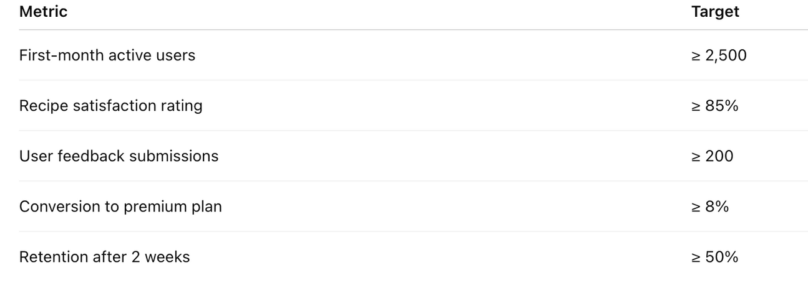

KPIS TO TRACK POST-LAUNCH

Slide 24
GO-TO MARKET STRATEGY
Target Market Focus:
Launch in 4 pilot cities — New York City, Los Angeles, San Francisco, and Chicago — targeting 18–35-year-old foodies, health-conscious users, culinary students, and R&D professionals.
Influencer Marketing & Content Strategy:
Partner with 8 micro-influencers (5K–25K followers) on TikTok, Instagram, and YouTube Shorts to promote Flavor Forge with personal “Flavor Profiles,” grocery haul videos, and recipe trials.
College & Culinary School Activations:
Collaborate with food science and culinary schools ( UMass, Johnson & Wales UCLA Extension) to recruit beta testers and host campus launch events with hands-on demos.
Strategic Brand Partnerships:
Co-market with grocery chains: (Stop & Shop, Aldi, Star Market,Big Y) and emerging food brands to integrate real products into personalized grocery lists and in-app flavor bundles.
Launch Promotions:
Offer early-access invite codes, free 30-day premium trials, and referral rewards ($5 credit per friend) to boost organic user acquisition.
App Store & Digital Presence:
Pre-launch landing page to capture 3,000+ waitlist signups; optimize App Store listings with preview videos, keywords, and testimonials for high discoverability.

Slide 25
GROWTH OF FLAVOR FORGE
Expand features: add real-time food scanning, mood-based suggestions, and seasonal recipe updates.
Integrate with wearable tech (Apple Health, Fitbit) to personalize by activity and health data.
Launch paid tiers with perks: personalized grocery lists, cultural recipe bundles, and AR tastings.
Leverage user data to release targeted “flavor drops” (limited recipe packs inspired by trending tastes).
Scale globally with cultural flavor localization — include Latin American, Asian, African cuisines.

Slide 26
Leverage B2B Opportunities: Provide flavor trend analytics and personalized menu insights to restaurants, meal kit companies, and grocery retailers.
Launch Flavor Forge Marketplace: Sell branded spice blends, cooking tools, and curated pantry bundles directly through the app.
Introduce Flavor Forge Kids: Create a child-friendly version focused on healthy eating habits and family-oriented recipes.
Bundle with Wellness Platforms: Partner with fitness, health tracking, and food delivery apps to offer integrated subscription plans.
Enter Corporate Wellness Space: Offer AI-powered meal planning tools for employee health programs and workplace nutrition.
AFTER MARKET STRATEGY (RETROFIT AND EXPANSION)

Slide 27
🚀 Version 1.0 — MVP Launch (Q3 2025)
Personalized meal suggestions
Grocery list generation
Basic dietary filters (vegan, gluten-free)
Core AI flavor pairing engine
Target: USA (NYC, LA, SF, Chicago)
🌟 Version 1.5 — Core Refinement (Q1 2026)
Mood-based meal suggestions
Enhanced customization & onboarding
Improved grocery list UI
Early food brand partnerships
Target: USA + Canada
ROADMAP
✨ Version 2.0 — Ecosystem Integration (Q3 2026)
Grocery delivery app integration
Diet trends analytics
Gamification (badges, challenges)
Social sharing of flavor profiles
Target: USA, Canada, UK, Australia
📈 Version 2.5 — B2B & Research Tools (Q1 2027)
Dashboard for food brands/researchers
Ingredient pairing API
Seasonal & regional dish suggestions
Target: North America + Western Europe
🌍 Version 3.0 — Global Expansion (Q3–Q4 2027)
Multilingual support (Spanish, French, Hindi, etc.)
Localized flavor databases
Regional partnerships
Target: Asia, Latin America, Europe, Middle East
🧡 Version 3.5+ — Personal AI Chef (2028+)
Voice assistant integration
AI Chef with cooking walkthroughs
Fridge-based meal suggestions
Optional smart kitchen sync
Target: Global

Slide 28
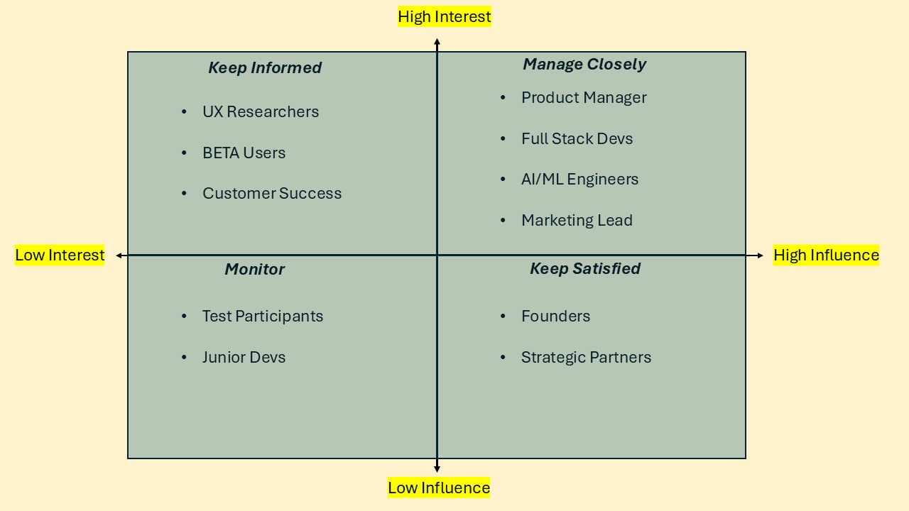
KEY STAKEHOLDERS

Slide 29
FIGMA LINK
CLICK HERE FOR THE BOARD

Slide 30
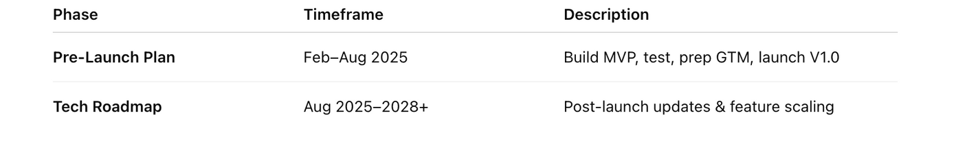
CONCLUSION
Flavor Forge is not just another food app — it’s an AI-powered ecosystem that reimagines how we experience flavor, health, and food innovation.
By solving the gaps in today’s food-tech landscape, we provide hyper-personalized, adaptive culinary experiences tailored to individual taste profiles, moods, and dietary needs — all while promoting sustainable habits and data-driven decisions.
Our vision is supported by:
A clearly defined MVP built on AI personalization and grocery integration
A 6-month product launch roadmap that transitions seamlessly into a long-term tech roadmap
A strategic go-to-market plan focused on early adopters, influencer marketing, and B2B brand alignment
Proactive risk identification and cost mitigation strategies that protect scale and longevity
Strong stakeholder engagement across product, culinary, marketing, and data science teams
With features like Flavor Forge Kids, B2B analytics tools, and a scalable marketplace, we extend our impact well beyond individual users — empowering chefs, food brands, and families alike.
By combining real-time user data, emotional cues, and cultural flavor mapping, Flavor Forge is uniquely positioned to become the go-to platform for personalized eating worldwide.
We don’t just recommend food — we redefine flavor innovation, one profile at a time.

